Slide 1
Place of Performance

Slide 2
Place of Performance
For Goods/Supplies: Items being manufactured should reflect the manufacture site as the place of performance. All other goods should enter the location the item was taken from inventory (e.g., the store location, etc.).
For Services: The predominant place of performance at the time of award. Predominance is based on funding. If funds are equal, Contracting Officers (COs) should use their best judgement.
  In the case of subscription services, software licenses, or similar type services; use the location where these services are being used.
  In the case of services that begin in one location and end in another (e.g., shipping); use the destination.
  In the case of services being performed in oceans/seas, choose the closest major city (if in U.S. waters). In another country's waters, choose that country. If in open waters, choose the closest country and choose the closest major city if that country is the U.S.
  In the case of services being performed in the atmosphere or space, choose the location from which the equipment conducting the services was launched.
  If the place of performance is not specified by the government in the Statement of Work or Performance Work Statement, and the CO does not have any other information indicating a specific location, the CO may use the contractor's location as the place of performance.
If the place of performance is located in the U.S. in an area that has no ZIP Plus 4 code (e.g., a national park, a remote location, etc.), use the closest location that does have a ZIP Plus 4.

Slide 3
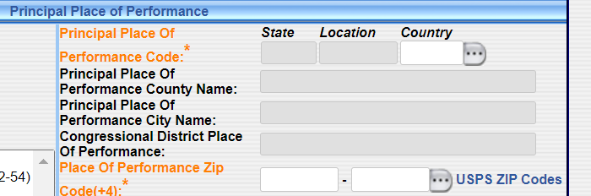
Place of Performance
Use the USPS Zip Code look up

Slide 4
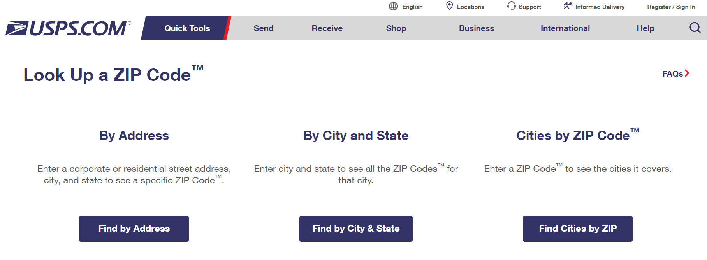
Place of Performance

Slide 5
Place of Performance
Where to find the information? For services and manufactured goods:
Statement of Work if the Government is specifying the place of performance.
  In your review of SOW\PWS you should be looking for this information and asking the program office about it.
If the Government chooses not to specify the place of performance and you are going to be negotiating the award, then you should be including the clause 52.215-6 Place of Performance.
  The vendor will be telling you what the Place of Performance is, and you should use that to populate the FPDS contract action report.
COs should be REVIEWING the file to ensure this information matches what is in FPDS.
REMEMBER: If the place of performance is in the contract file, make sure it matches what is reported in FPDS.

