Slide 1
FPDS Dollar Amounts

Slide 2
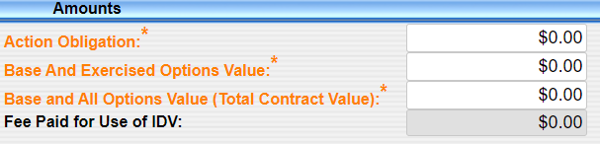
Dollar Amounts
Action Obligation = Amount obligated for this action.
Base & Exercised Options= Amount obligated plus any exercised options.
Base & All Options* (Total Contract Value)=Amount of base and all options exercised or not. This is your total estimated contract value.
*Your agency may handle 52.217-8 Option to Extend Services differently. Please check with your policy office.

Slide 3
Dollar Amounts
Remember that the Total Column in FPDS represents the total dollars as of the most recent modification, not the total for that particular mod.
Example: Your contract has 5 modifications entered in FPDS. The totals as of modification 5 are $500,000. If you look at any of the previous entries (Mod 1-4) in FPDS the total columns will also show $500,000 not the totals specific to each modification.

Slide 4
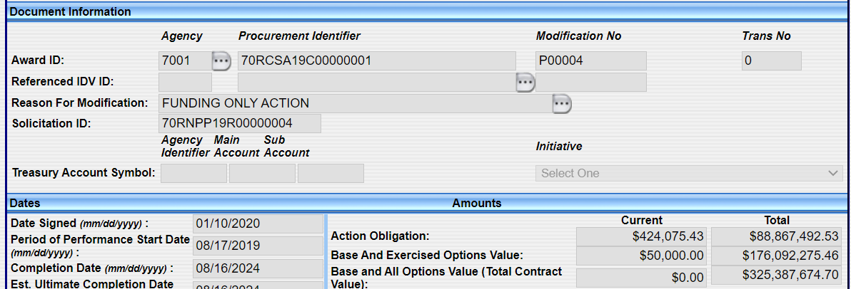
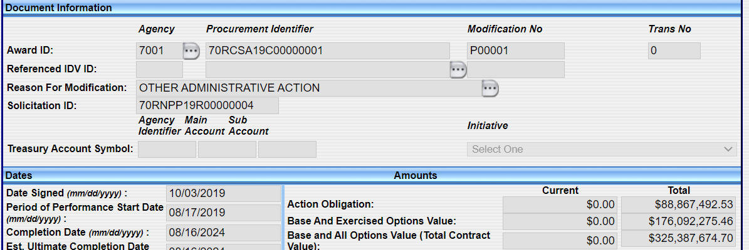
Dollar Amounts
In the example below you see the total columns show the most recent totals, i.e., as of mod 4. If you look at mod 1, the total columns represent the most recent totals, as of mod 4, not the totals as of mod 1.
Mod 4 Mod 1

Slide 5
Data Elements: Dollar Amounts
Common mistakes:
  Totals are incorrect:
    FPDS calculates totals based on ‘APPROVED’ FPDS reports.
    Creating a draft FPDS report and never approving it means your totals will be wrong with your next FPDS report.
    In these cases, DO NOT try and manually adjust the totals. Instead approve the draft report. If you still have issues, contact your system admin.
  Incorrectly adding money:
    When modifying a contract to add money be careful not to incorrectly add it to all the fields unless you really did that kind of modification (see next slide).
  IF YOU NOTICE ISSUES WITH THE TOTAL FIELDS,NEVER ADJUST TOTALS MANUALLY. ASK FOR HELP FROM YOUR SYSTEM ADMINISTRATORS, etc.

Slide 6
Data Elements: Dollar Amounts
Examples:
  Purchase Order (no options) originally awarded for $150,000; Mod 1 de-obligates $20,000. Should be reported as:
  Definitive Contract (1 option) originally awarded for $200,000; total estimate at award was $300,000 if all options exercised. Mod 1 exercises the Option 1 for $100,000. Should be reported as*:
*In this example-the option amount is already accounted for in the Base and All Options field so you would not add the $100,000 in that field. The only time you would add money to this field is if you added additional work under the option which requires re-negotiation

Slide 7
Data Elements: Dollar Amounts
If you are awarding an IDV be sure you are filling out these two data elements correctly:
  Base and All Options: For IDVs this is the mutually agreed upon total estimated contract value including all options (if any, i.e, if you are actually obligating money on the IDV itself) AND the estimated value of all potential orders.
  Total Estimated Order Value: For IDVs, enter the total estimated value for all potential orders that are expected to be placed against this IDV. Do NOT include any obligated amounts that may have been placed on the IDV itself.

Slide 8
Dollar Amounts
Examples:
  Contract is for $200,000-total estimated cost (i.e., base and all options). I’m obligating $100,000 the first year. I have an option for $100,000. How do I report?
      For the initial award (mod=0):
      Obligation: 100,000
      Base and Exercised: 100,000
      Base and All Options: 200,000

Slide 9
Dollar Amounts
Mod 1 Exercising the first option:
Current Total
Obligation: 100,000 200,000
Base and Exercised: 100,000 200,000
Base and All Options: 0 200,000

Slide 10
Dollar Amounts
If you are doing a closeout modification where I am deobligating excess funds, do I also need to deobligate the amount from the Base and All Options data element (the Total Estimated Contract Value)?
No. The Base and All Options data element represents the total estimated contract value and does not get adjusted when deobligating excess funds at the end of the contract. You would deobligate funds in the Base and All Options data element if you were removing work from the contract.

Slide 11
Dollar Amounts
Examples:
Mod 2 is a closeout modification and you have excess funds to deobligate. The contract had a total estimated contract value of $200,000. You obligated $200,000. There were no options. The total of all invoices submitted by the contractor and paid totaled $195,000. How do you report that in FPDS?
Mod 2:
Current Total
Obligation: (5,000) 195,000
Base and Exercised: (5,000) 195,000
Base and All Options: 0 200,000

Slide 12
Dollar Amounts
Examples:
Your contract had a total contract value of $300,000 (base and all options). You obligated $200,000 for the base period and there is one option for $100,000. Modification 1 is removing certain tasks from the contract resulting in a decrease of $10,000.
Mod 1:
Current Total
Obligation: (10,000) 190,000
Base and Exercised: (10,000) 190,000
Base and All Options: (10,000) 290,000

