Slide 1
Period of Performance Start Date
Should the Period of Performance Start Date in FPDS correspond to the Effective Date in my Contract Writing System?
  No! The Period of Performance Start Date is when the period of performance starts which doesn’t always correspond to the Effective Date.
  Example:
  You award a contract on 9/1/21. For whatever reason you make the effective date 9/2/21. The period of performance doesn’t start until 10/1/21. What do you report in FPDS?
  Date Signed: 9/1/21
  Period of Performance Start Date: 10/1/21

Slide 2
Be Aware of Your Contract Writing Systems Settings
If your CWS is causing the wrong dates to pre-populate in FPDS then you need to :
Adjust your configuration settings
Contact the CWS provider\manager to report the issue ASAP

Slide 3
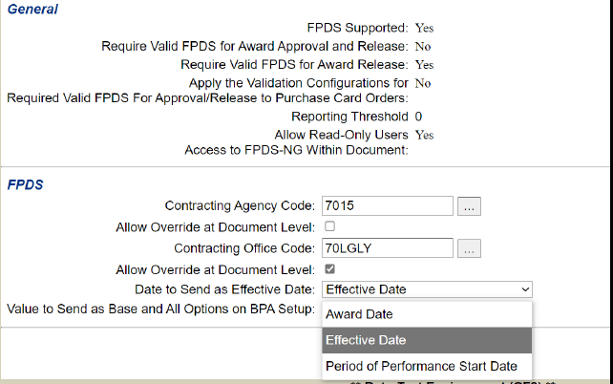
CWS Site Settings example:
Should be set to Period of Performance Start Date (and really shouldn’t reference Effective Date at all).

Slide 4
Data Elements: Dates
Be sure you know what date you mean:
  Date Signed = Date the award was signed. If funds are involved should also be the date the action was obligated.
  Period of Performance Start Date= The period of performance start date, NOT THE EFFECTIVE DATE
  Completion Date = The date the period of performance will end.
  Est. Ultimate Completion Date = The estimated date the period of performance will end when\if all options are exercised.
  Last Date To Order = For IDVs

Slide 5
Data Elements: Dates
Common mistakes:
  Starting a draft FPDS report with today’s date as the Date Signed and not updating the Date Signed when the action is actually awarded.
  Incorrectly entering the Period of Performance Start Date as the Date Signed when that isn’t the case.
  Forgetting to update the Completion Date whenever the period of performance has been extended\option exercised\termination.
  Changing the Completion Date on closeout- DO NOT DO THIS! The Completion Date is NOT the closeout date- it’s the date the period of performance ended.

Slide 6
Dates
Examples:
Contract award was signed on 11/1/2021. The contract has base period of 11/2/2021-11/1/2022. There is one option year.
REPORT:
Date signed:11/1/2021
Period of performance start date: 11/2/201
Completion date: 11/1/2022
Ultimate Completion date: 11/1/2023

Slide 7
Dates
Examples (cont’d):
Same contract and now we are issuing a modification to exercise the option year. The modification is signed 10/31/2022.
REPORT:
Date signed: 10/31/2022
Period of performance start date: Grayed out on modifications
Completion date: 11/1/2023 (UPDATED)
Ultimate Completion date: 11/1/2023 (Unchanged-does not get updated)

